Slide 1
CO2 Carbon Emissions Data Analysis
Analyzing and Predicting CO2 Emissions Impact on Climate Change

Slide 2
Date:11 November 2024 Team Members: Matsape Maphuthi Maphike Nomathemba Annah Ramoshaba Jeanet Chauke Mikateko Prudence

Slide 3

Introduction
Project Overview
Objective: Analyze CO₂ emissions from the agri-food sector and predict climate impact.
Data Sources: Compiled from Food and Agriculture Organization (FAO) and the Intergovernmental Panel on Climate Change (IPCC), includes emissions from savanna fires, forest fires, rice cultivation, pesticides manufacturing, food transport, and fertilizer manufacturing.
Importance: Helps policymakers, businesses, and environmental groups make sustainable decisions.

Slide 4
Problem statement
Issue: Rising CO₂ emissions in the agri-food sector threaten climate stability.
Problem Focus: Understanding the sector's CO₂ contribution and identifying actionable insights for reduction.

Slide 5
Project Objectives
To understand the impact of agricultural activities on climate change and develop strategies for sustainable practices.
Primary Goals:
Perform exploratory data analysis.
Engineer features to uncover meaningful insights.
Develop predictive models for CO₂ emissions’ impact on temperature variations.
Provide recommendations for sustainable practices.

Slide 6
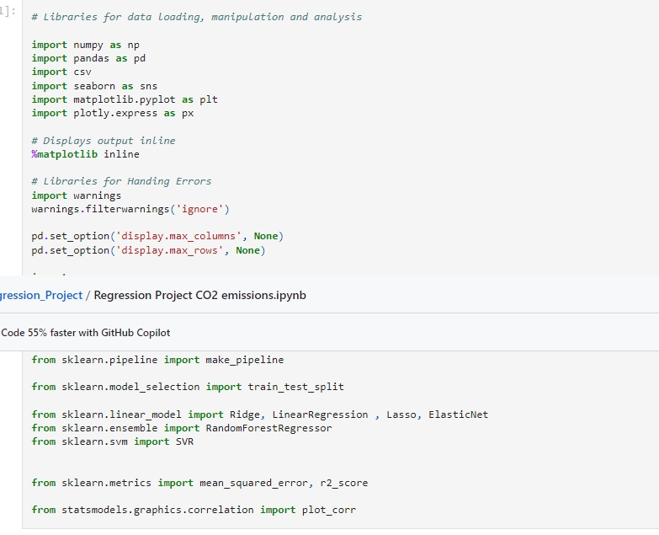
Methodology Overview
Data Analysis: Pandas and Numpy for manipulation; Matplotlib and Seaborn for visualization.
Modeling: Supervised learning models for predictive insights.
Feature Engineering: Techniques to enrich dataset and enhance model accuracy.

Slide 7
Structure of the Notebook
Key Sections:
Import Packages
Loading data
Data Cleaning
Exploratory Data Analysis (EDA)
Feature Engineering
Modeling and Model Evaluation
Conclusion and Recommendations

Slide 8
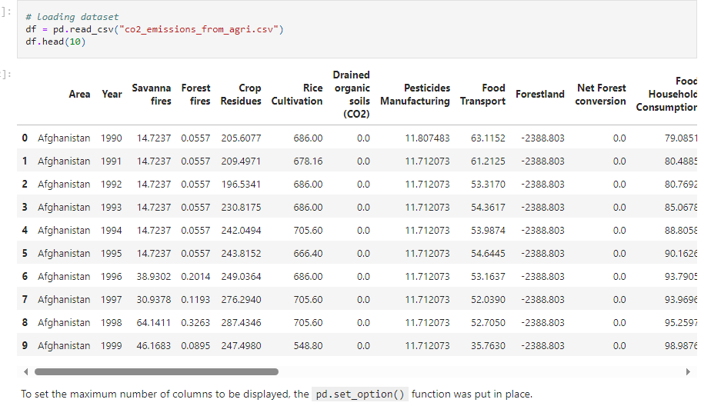
Loading data
The data used for this project was in the 2401PTDS_REGRESSION_PROJECT folder on GitHub.
To better manipulate and analyze the co2_emissions_from_agri.csv file, it was loaded into a Pandas Data Frame using the Pandas function.

Slide 9
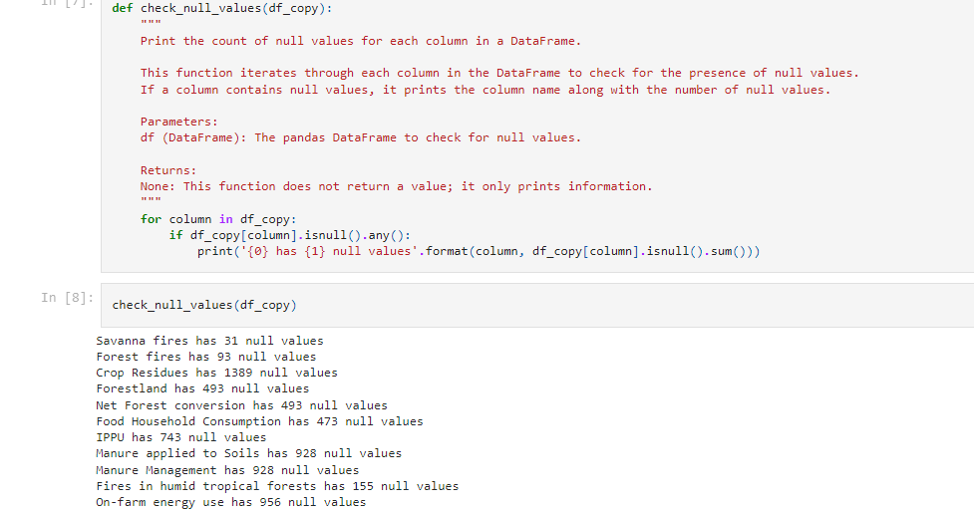
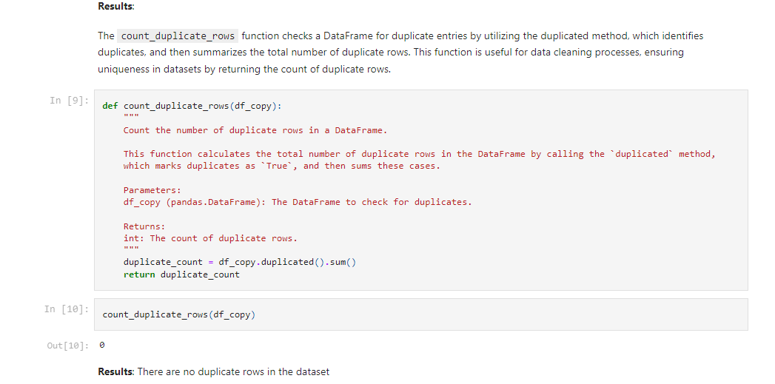
Data Cleaning & Preparation
Cleaning Steps: Handling missing values, correcting data types, removing duplicates.
Goal: Ensure a reliable dataset for analysis and modeling.

Slide 10
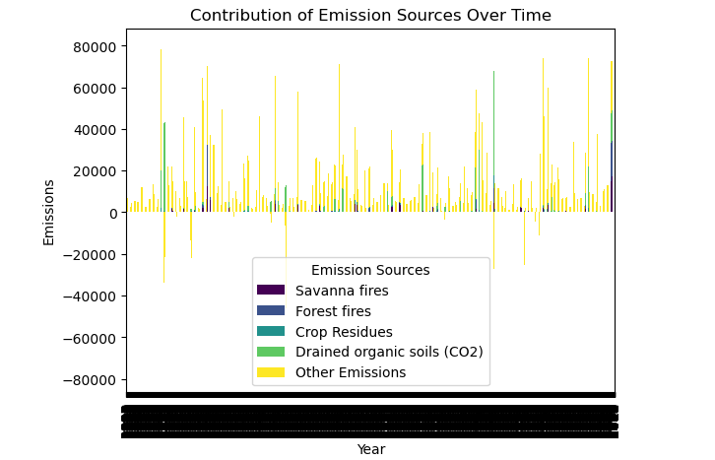
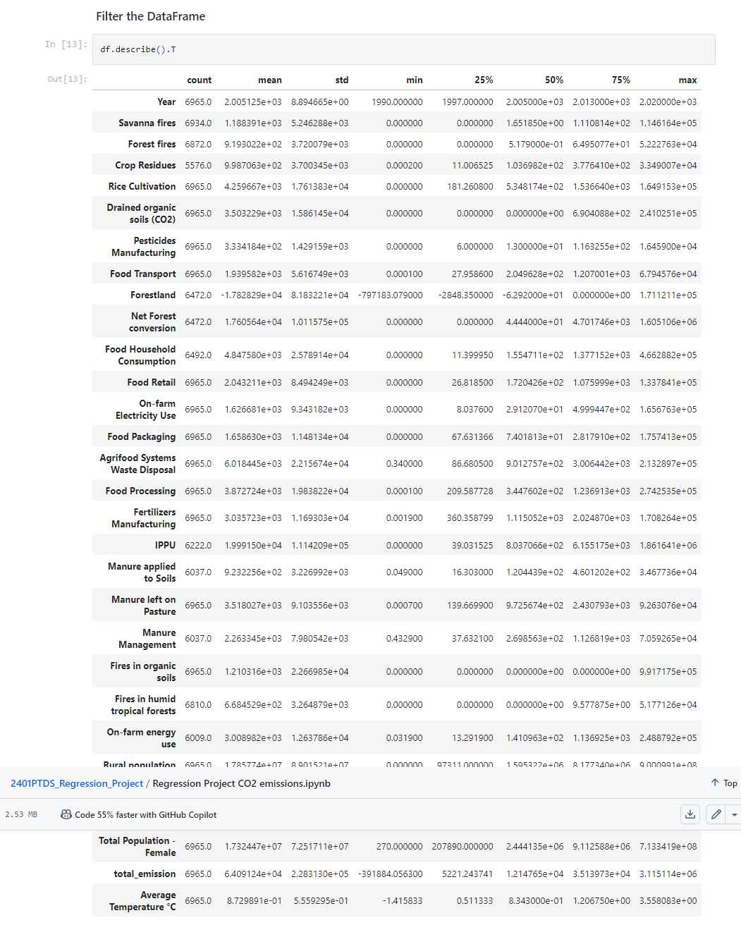
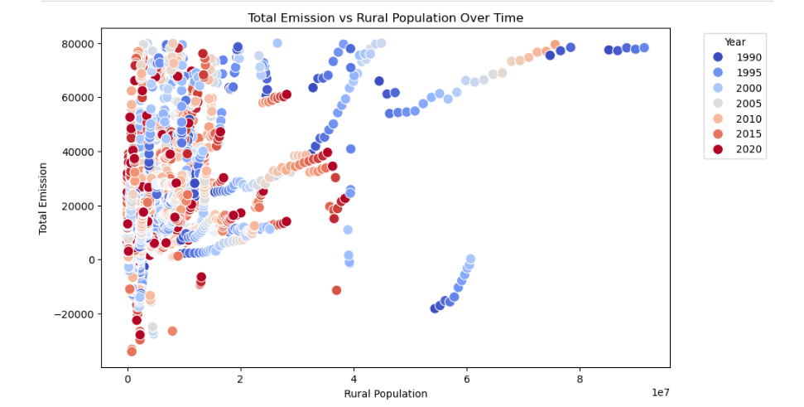
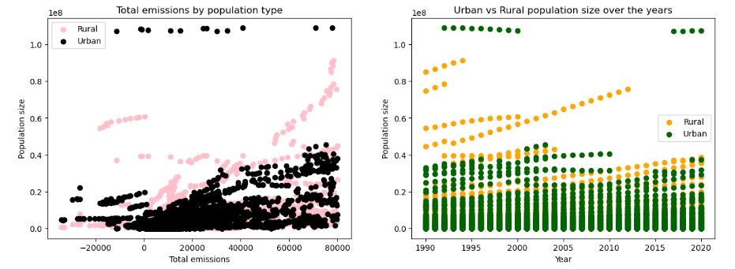
Exploratory Data Analysis (EDA)
Insights:
Initial trends in emissions by source and region.
Visualization of emissions over time.
Key Observations: Highlight significant patterns, outliers, or correlations found.

Slide 11
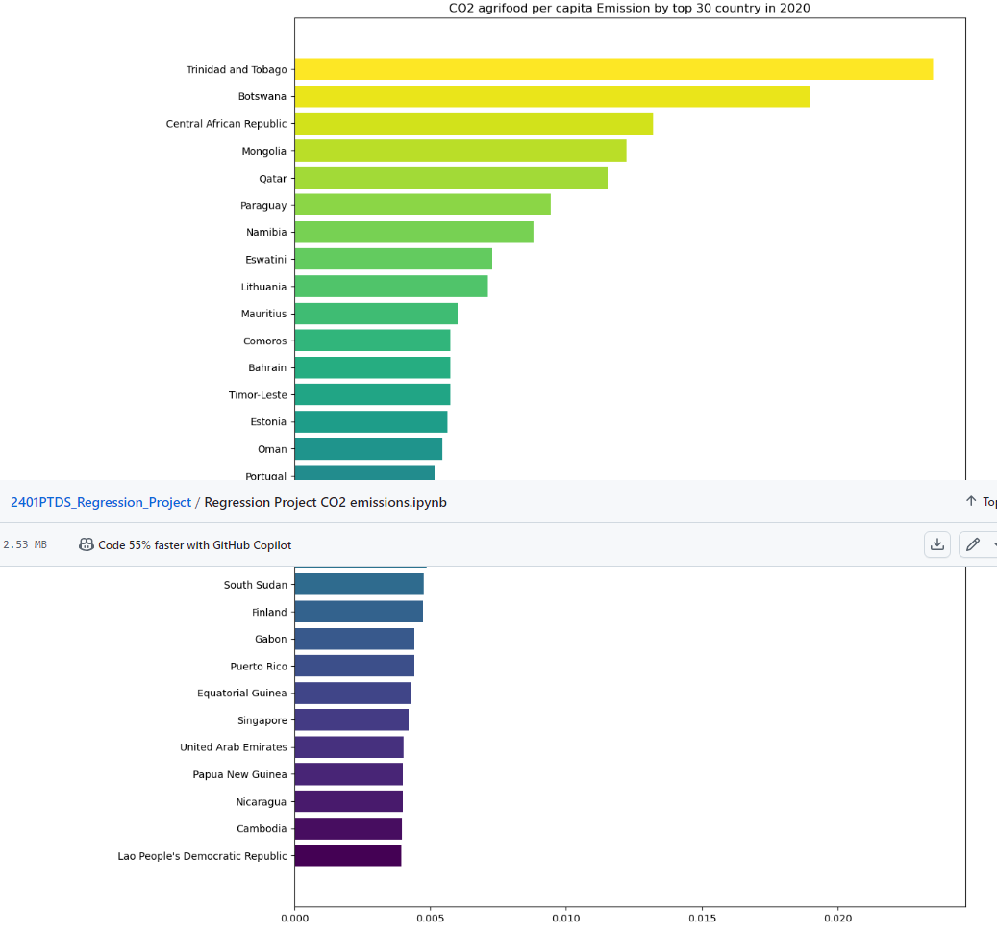
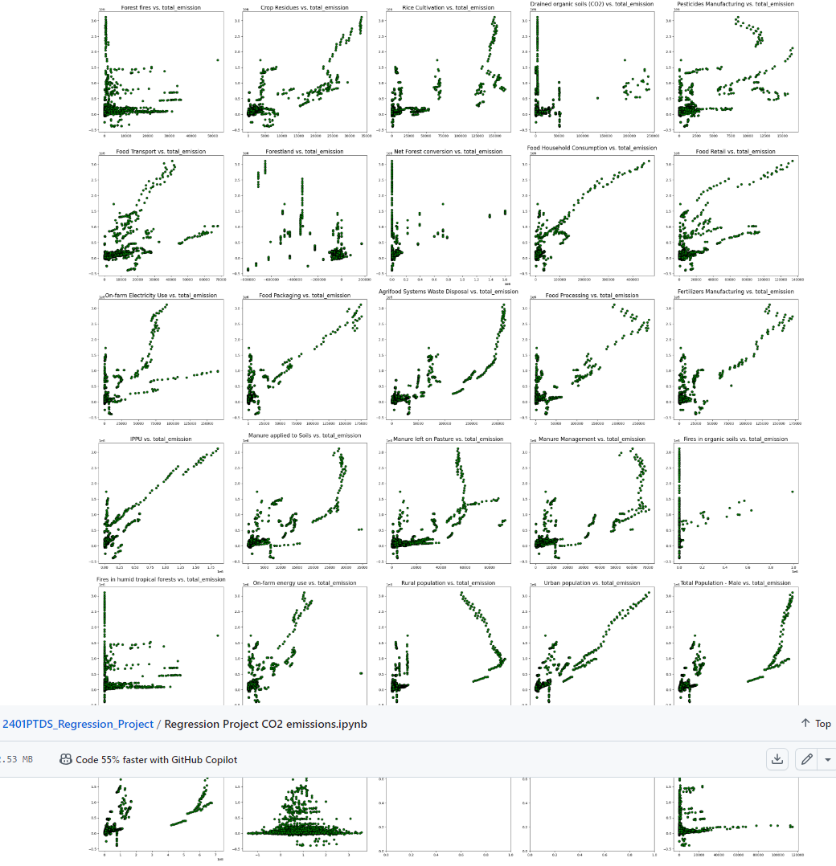
Feature Engineering
Objective: Extract meaningful features for improved model performance.
Examples:
Derived emissions metrics
Regional impact factors

Slide 12
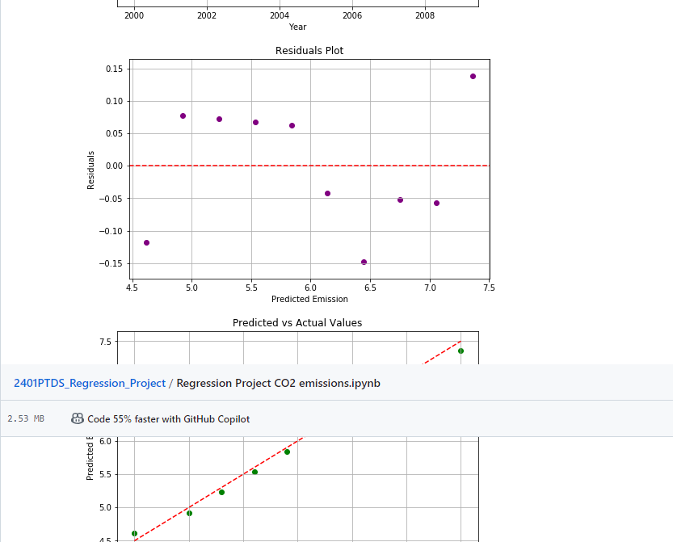
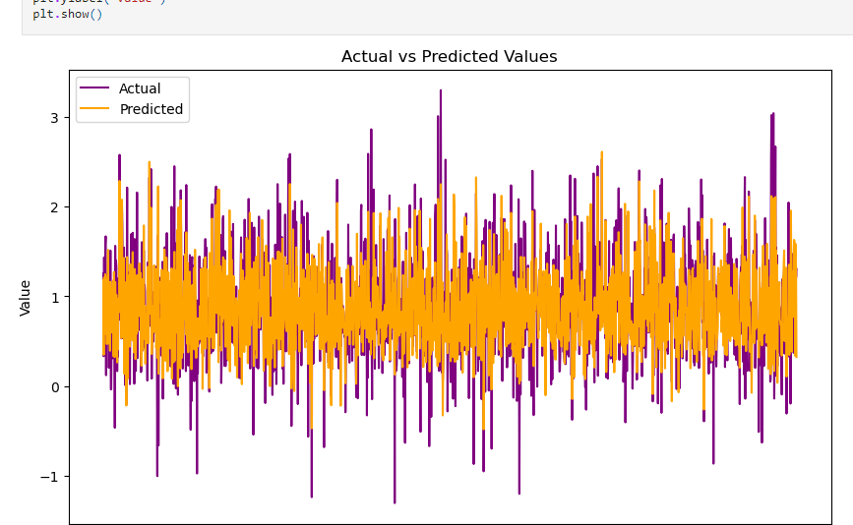
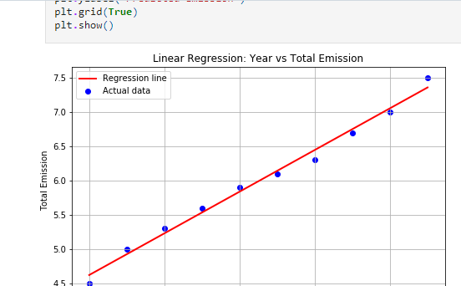
Modeling Approach
Algorithms: Linear Regression, Random Forest Regression, Bagging Regression, Gradient Boosting Regression (XGBoost)
Evaluation Metrics: R², Mean Squared Error (MSE)
Model Selection Criteria: Accuracy, interpretability, scalability.

Slide 13
Conclusions and Recommendations
Effective emission reduction strategies are essential for climate mitigation in agriculture. The model offers a predictive basis for future temperature impacts based on emissions control.
Recommendations:
Prioritize emission reductions from the highest-contributing sources.
Enhance policy measures for emissions in rice cultivation and fire management.
Invest in sustainable agricultural technologies and carbon offset programs.
Future Work:
Propose areas for further research or additional questions that emerged from the project. Suggest improvements in data collection, analysis methods, or other aspects that could enhance future studies.

Slide 14

Thank you

